Slide 1

Design & Implementation of Healthcare chatbot model
SUNIL BHAGWAT

Slide 2



Introduction
The healthcare sector is one of the largest focus areas in the world today. Individuals are becoming increasingly susceptible to lifestyle diseases.
Early diagnosis and treatment of diseases becomes a key factor in this regard. The solution is adopting healthcare chatbots.
Today there is an epoch of Artificial Intelligence. The science behind human thinking and acting developed by psychologists and philosophers, welcomed by technological experts with robust sophistication developed the science of Artificial Intelligence.
Natural Language conversational entities powered by AI, called Chatbots are the main focus of this study. They are very much popular these days because of various success stories and controversies created, including Amazon’s ALEXA, Apple’s SIRI and Microsoft’s TAY.

Slide 3
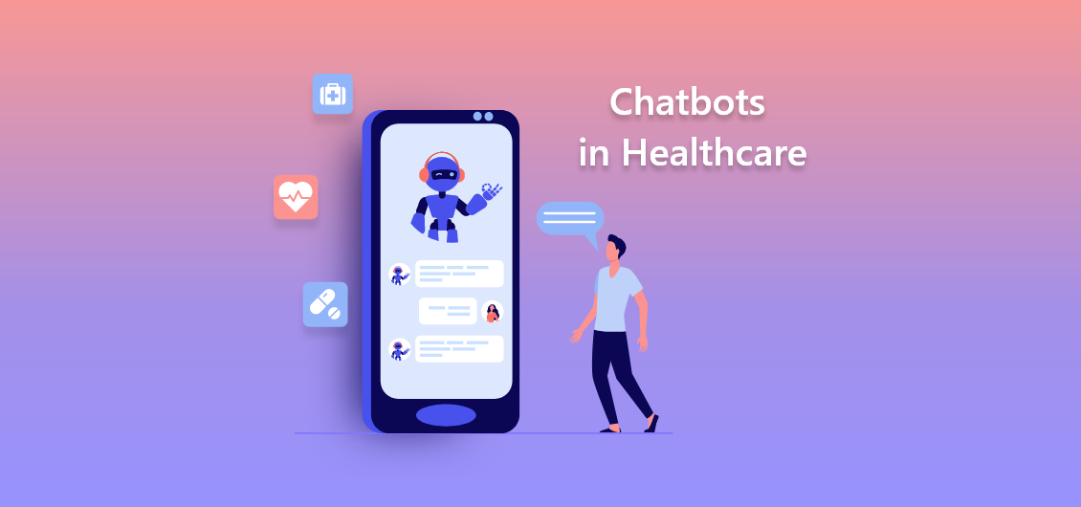
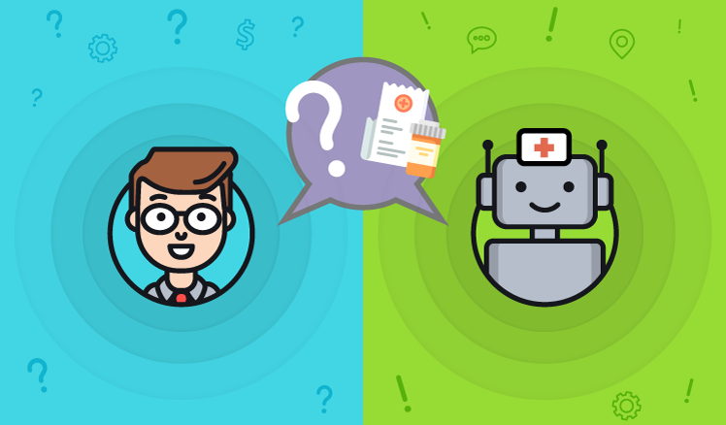

Abstract
The use of chatbots evolved rapidly in numerous ﬁelds in recent years,including Marketing, Supporting Systems, Education, Health Care, Cultural Her-itage, and Entertainment. In this project, we will create chatbot in Health care using LSTM, Bi-LSTM, GRU amd BERT. we will compare these algorithms and will conclude the best algorithm among these.

Slide 4
literature survey
Reference Papers
Customer Support Chatbot for Electronic Components.
Chatbot user interface for customer relationship management using NLP models
Depression Chatbot using Deep Learning
Multilingual healthcare chatbot using machine learning
Chatbot for healthcare system using artificial intelligence

Slide 5
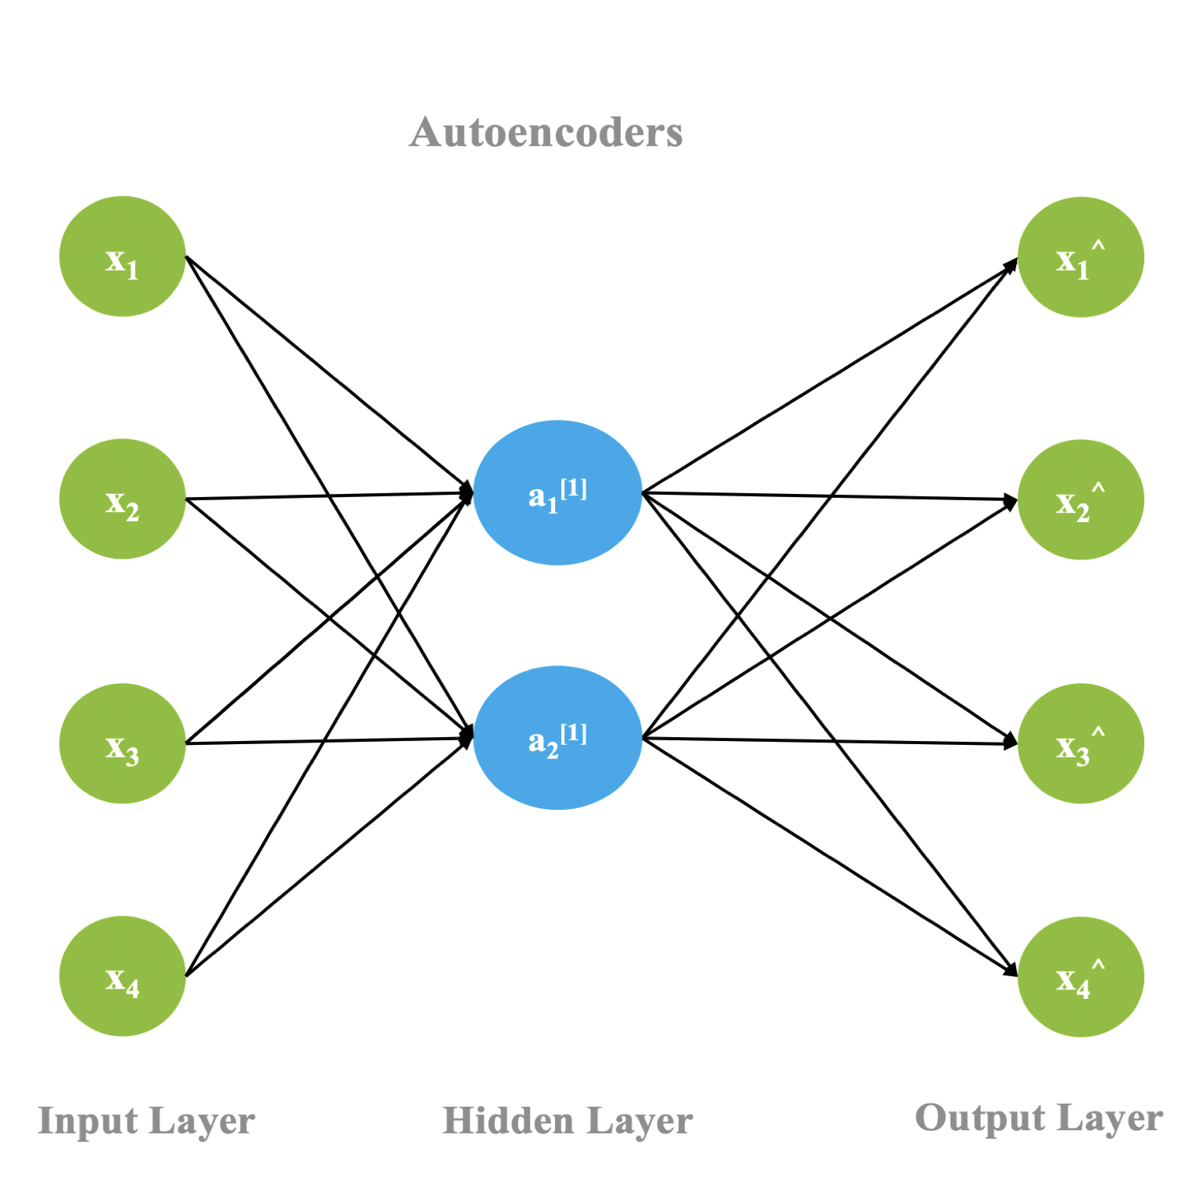
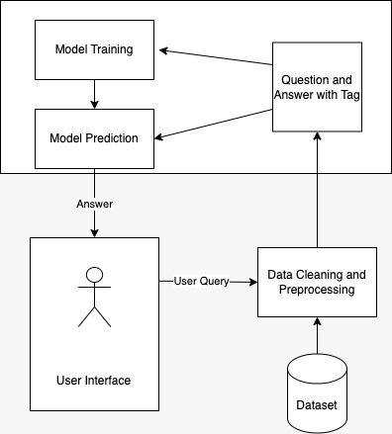
ARCHITECTURE
Flow Model – Chatbot Architecture Deep Learning Architecture

Slide 6
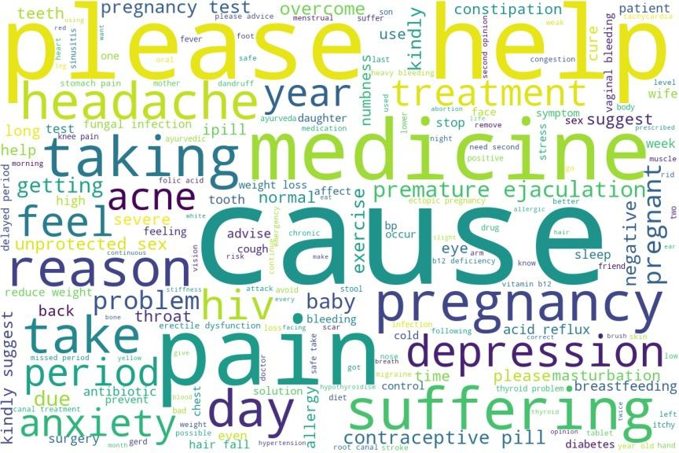
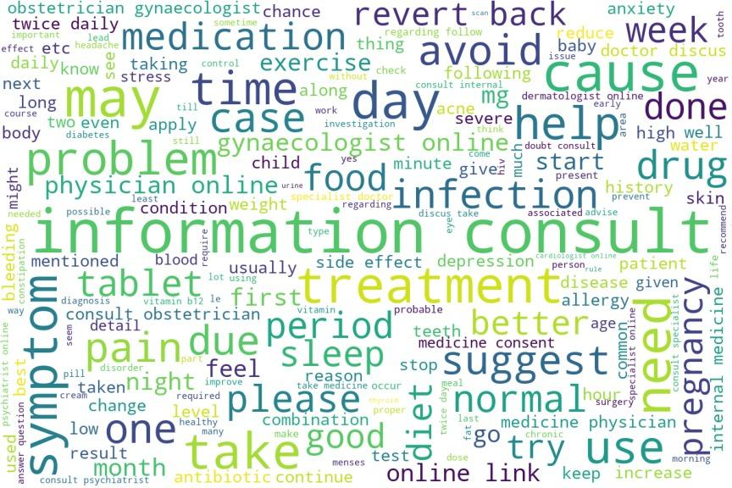
Dataset description
The Healthcare JSON dataset is a collection of data that includes question and answer pairs related to healthcare information. The dataset is structured in JSON format with 465 records, which makes it easy to use and integrate with other systems. The Dataset is web scraped from the Healthcare QA website icliniq.
EDA
Word Cloud from questions
Word Cloud from answers

Slide 7
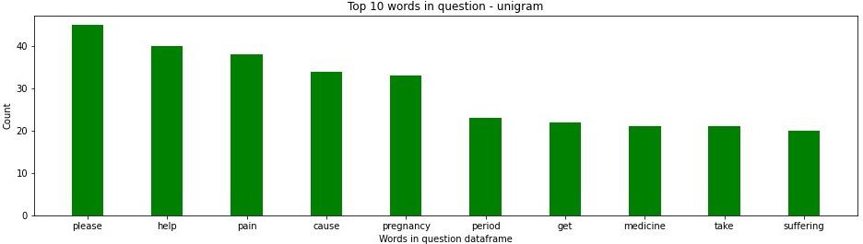
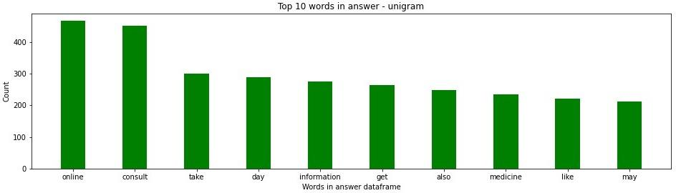
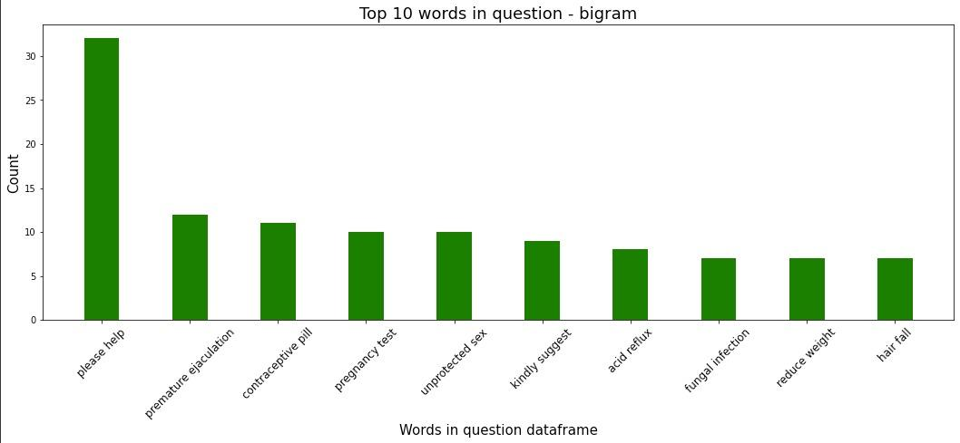
EDA

Slide 8
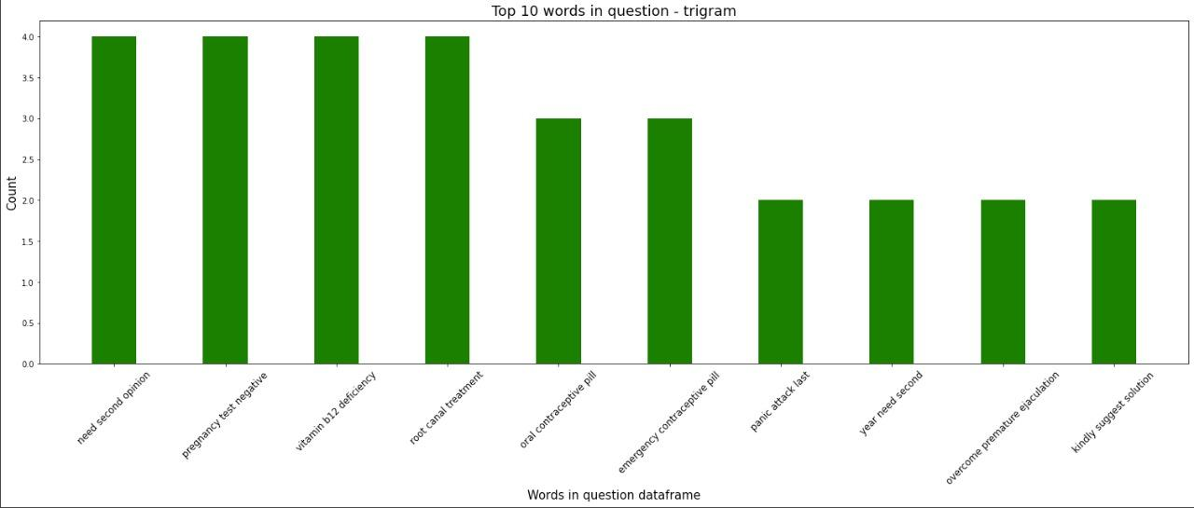
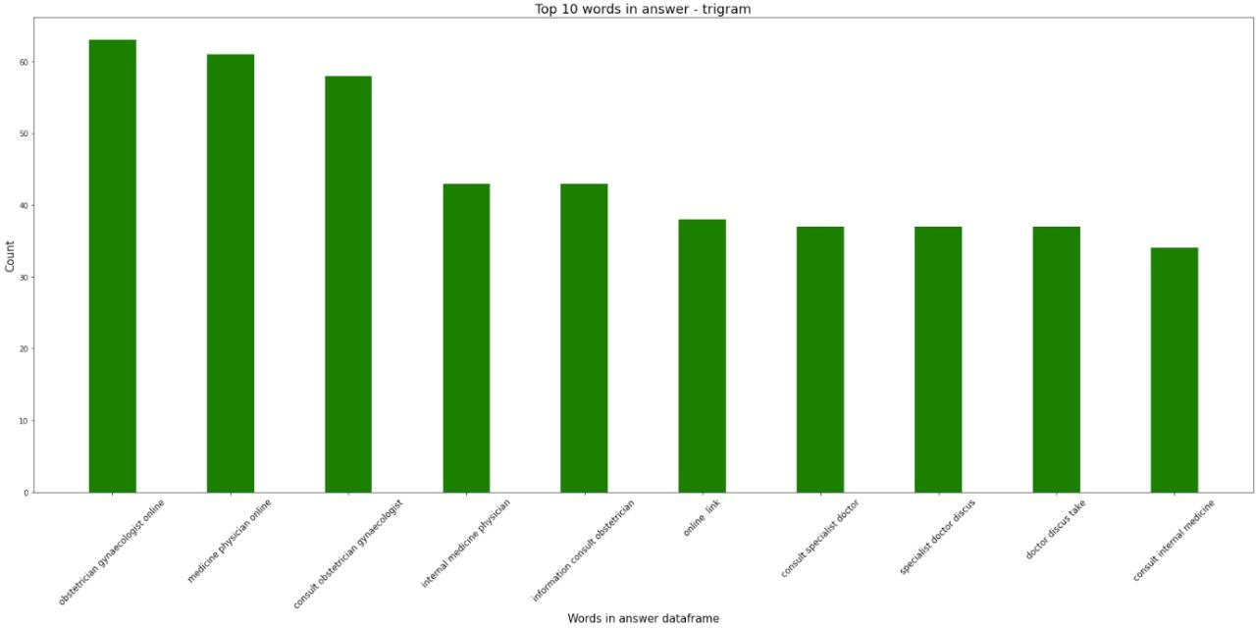
EDA

Slide 9
IMPLEMENTATION
The proposed system consists of a user-friendly chat interface through which a user can communicate with the system. Depending on the user input, the chatbot will provide relevant information about user queries. The system has pre-processed the healthcare question answer dataset using the techniques of text processing in NLP. These are some of the techniques used :
Tokenization
Stop Words Removal
Lemmatization
User input text is first converted into lower case which is known as case-folding. The lower case user input is raw text which is transformed into a bag of words using tokenization. This will separate the text into the terms that compose it.
Tokenization is useful for dealing with and analyzing each word independently. Further, all the punctuations are removed and the final bag of words is obtained.
In order to extract important keywords, stop words such as ‘a’, ‘an’, ‘the’, etc are removed from the bag of words obtained from the previous pre-processing step.
Removal of stop words is necessary as they take valuable pre-processing time and space.
The bag of words is then iterated and the root form of each word is generated using lemmatization.
Lemmatization considers the context and converts the word to its meaningful base form, which is called Lemma(better -> well).
Here, the system is using Word Net Lemmatizer to achieve the above process.

Slide 10
Cont’d…
Deep learning algorithm is used with 4 layers.
First layer 128 neurons, second layer 64 neurons and 3rd layer 32 neurons along with dropouts of 20% and 4th output layer contains number of neurons equal to number of intents to predict output intent with softmax.
Relu activation function is used in the dense layers.
Stochastic gradient descent is used as an optimizer.
The model is executed up to 100 epochs with a batch size of 5.

Slide 11
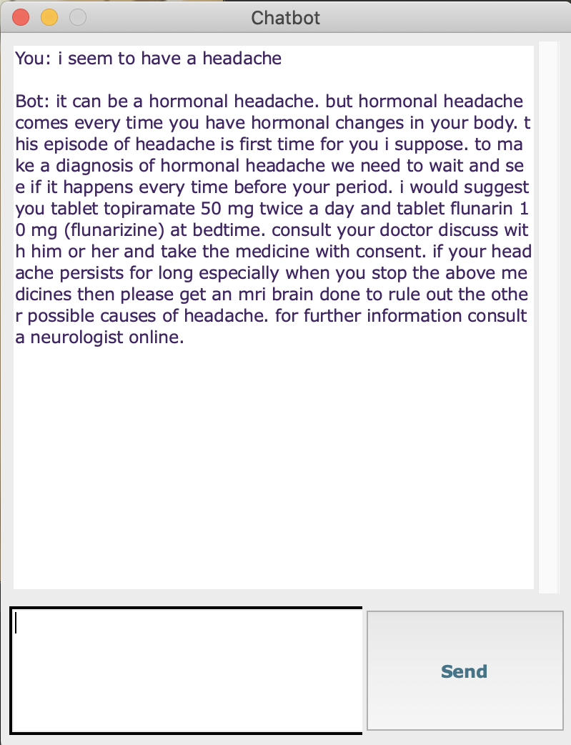
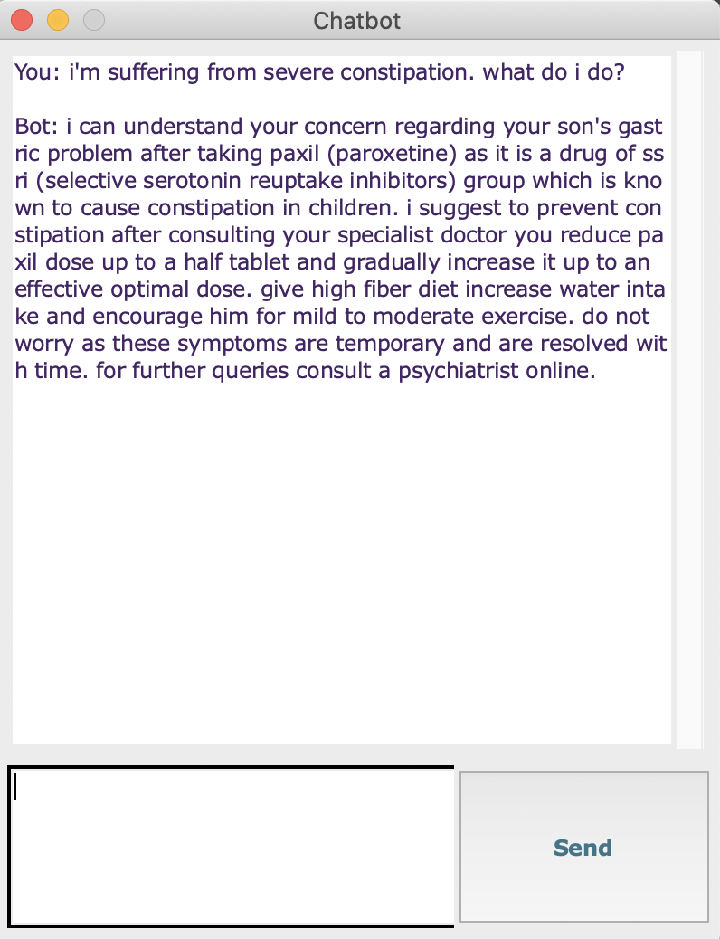
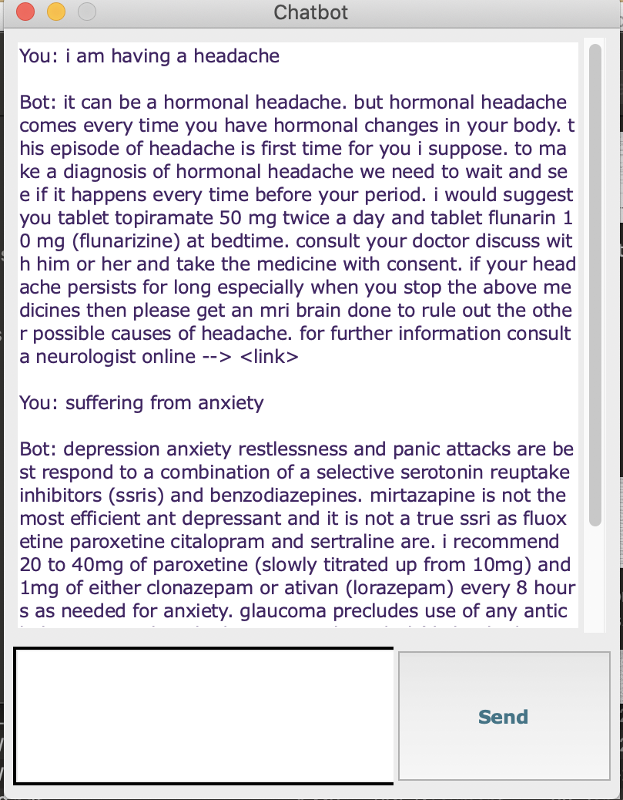
Implementation
A GUI is created using tkinter to provide the chatbot experience where user can enter their query and the system’s response is shown in the GUI.

Slide 12
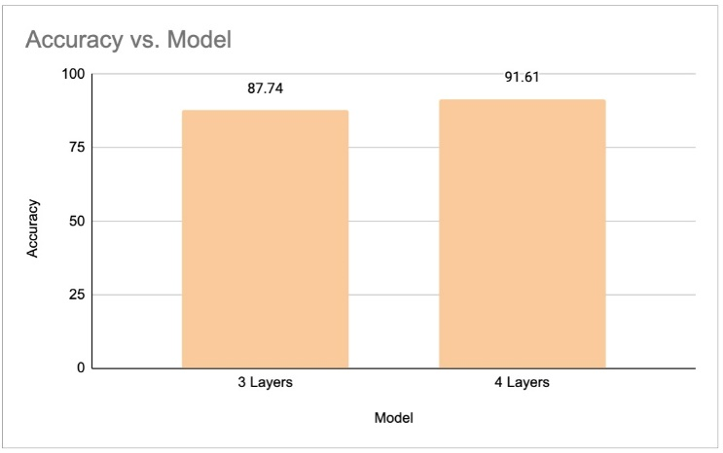
Results and Discussions
We have used the deep learning model utilizes a multi-layer perceptron architecture with 3 layers and 4 layers.
With Relu and Softmax activation functions, SGD optimizer, and the model is trained for the same number 100 epochs and with 4 layers, around 91% accuracy achieved.

Slide 13
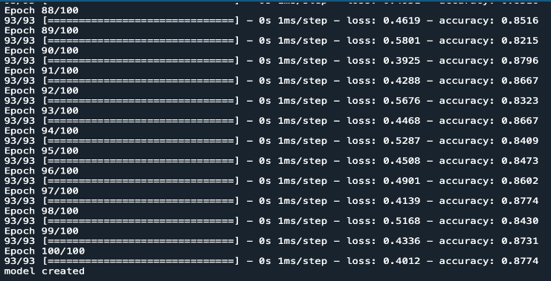
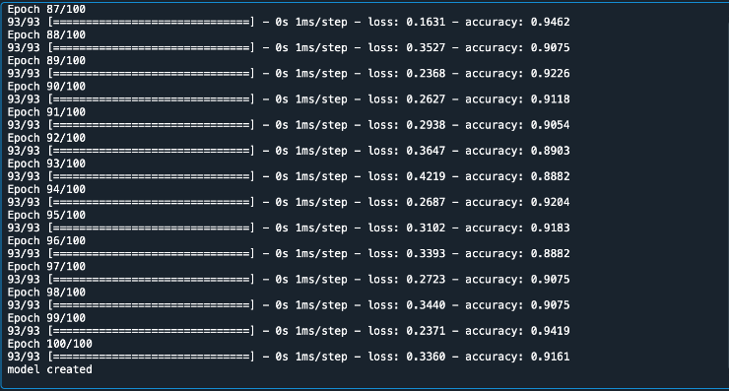
Snapshot of results…
Model accuracy for 3 dense layers
Model accuracy for 4 dense layers

Slide 14
Student Contribution
The use of chatbots evolved rapidly in numerous ﬁelds in recent years,including Marketing, Supporting Systems, Education, Health Care, Cultural Her-itage, and Entertainment. In this project, we will create chatbot in Health care using LSTM, Bi-LSTM and GRU. we will compare these algorithms and will conclude the best algorithm among these.

Slide 15
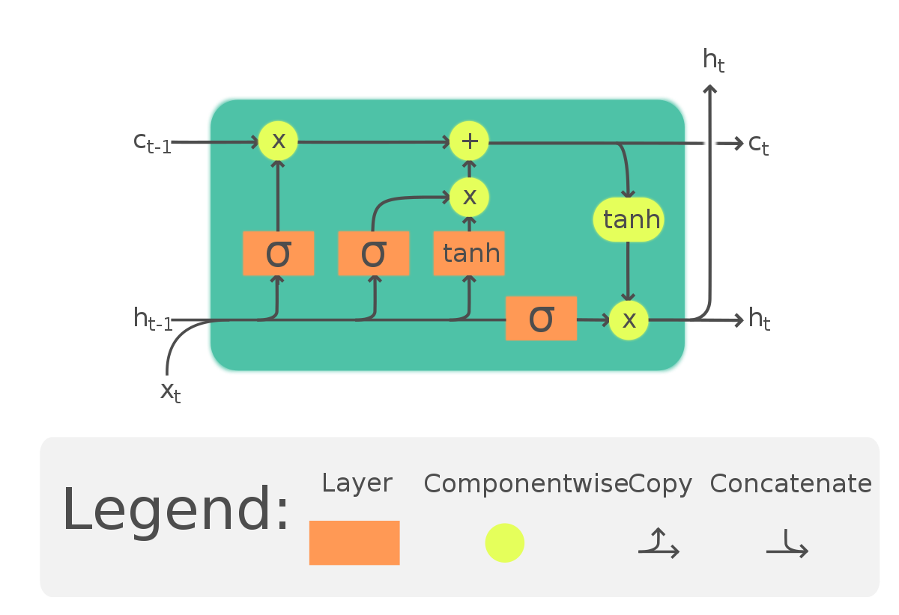
ALGORITHM
LSTM
Long Short-Term Memory Networks is a deep learning, sequential neural network that allows information to persist. It is a special type of Recurrent Neural Network which is capable of handling the vanishing gradient problem faced by RNN. LSTM was designed by Hochreiter and Schmidhuber that resolves the problem caused by traditional rnns and machine learning algorithms. LSTM will be implemented in Python using the Keras library.

Slide 16
ALGORITHM
LSTM Model Building
LSTM Algorithm is used to Build the Chatbot
LSTM layesr is added with 100 neurons and output layer contains number of neurons equal to number of intents to predict output intent with softmax.
Adam is used as an optimizer.
The model is executed up to 100 epochs with a batch size of 5.
Results
Accuracy is 1.00
Loss is 0.0013
Val_Accuracy is 0.2366
Val_loss: 4.9481

Slide 17
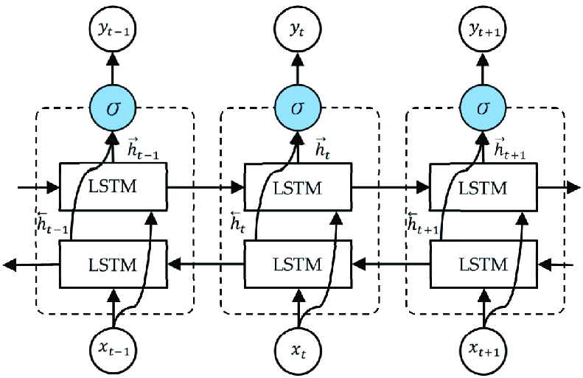
ALGORITHM
2. Bidirectional LSTM
A Bidirectional LSTM, or biLSTM, is a sequence processing model that consists of two LSTMs: one taking the input in a forward direction, and the other in a backwards direction. BiLSTMs effectively increase the amount of information available to the network, improving the context available to the algorithm

Slide 18
ALGORITHM
Bidirectional LSTM Model Building
Bidirectional LSTM Algorithm is used to Build the Chatbot
Bidirectional LSTM layesr is added with 100X2 neurons and output layer contains number of neurons equal to number of intents to predict output intent with softmax.
Adam is used as an optimizer.
The model is executed up to 50 epochs with a batch size of 5.
Results
Accuracy is 1.00
Loss is 0.0062
Val_Accuracy is 0.2258
Val_loss: 4.8577

Slide 19
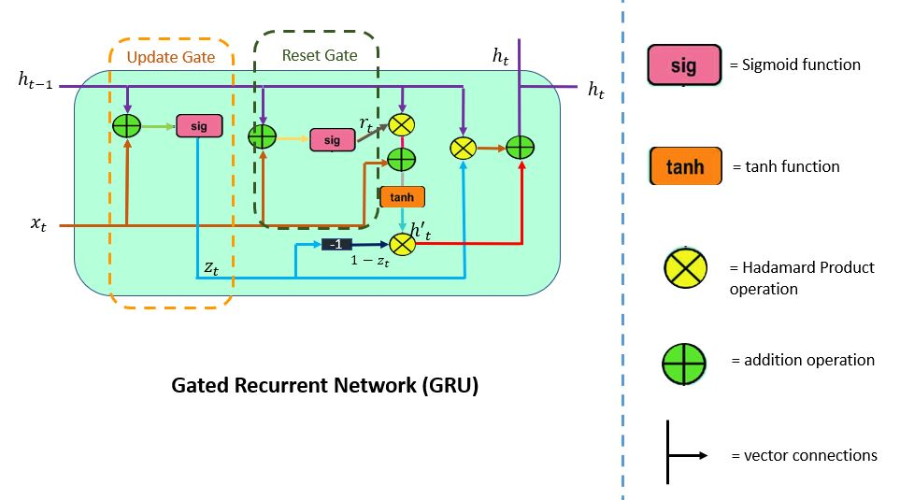
ALGORITHM
3. GRU
GRUs are very similar to Long Short Term Memory(LSTM). Just like LSTM, GRU uses gates to control the flow of information. They are relatively new as compared to LSTM. This is the reason they offer some improvement over LSTM and have simpler architecture.
Another Interesting thing about GRU is that, unlike LSTM, it does not have a separate cell state (Ct). It only has a hidden state(Ht). Due to the simpler architecture, GRUs are faster to train.

Slide 20
ALGORITHM
GRU Model Building
GRU Algorithm is used to Build the Chatbot
GRU layesr is added with 100 neurons and output layer contains number of neurons equal to number of intents to predict output intent with softmax.
Adam is used as an optimizer.
The model is executed up to 50 epochs with a batch size of 5.
Results
Accuracy is 1.00
Loss is 0.0084
Val_Accuracy is 0.2258
Val_loss: 6.1356

Slide 21
ALGORITHM Comparison
Model | Epoch | Batch Size | Accuracy | Loss | Val_Accutacy | Val_Loss
LSTM | 100 | 5 | 1 | 0.0013 | 0.2366 | 4.9481
BI-LSTM | 50 | 5 | 1 | 0.0062 | 0.2258 | 4.8577
GRU | 50 | 5 | 1 | 0.0084 | 0.2258 | 6.1356
Deep Learning | 100 | 5 | 0.9161 | 0.336 | - | -

Slide 22
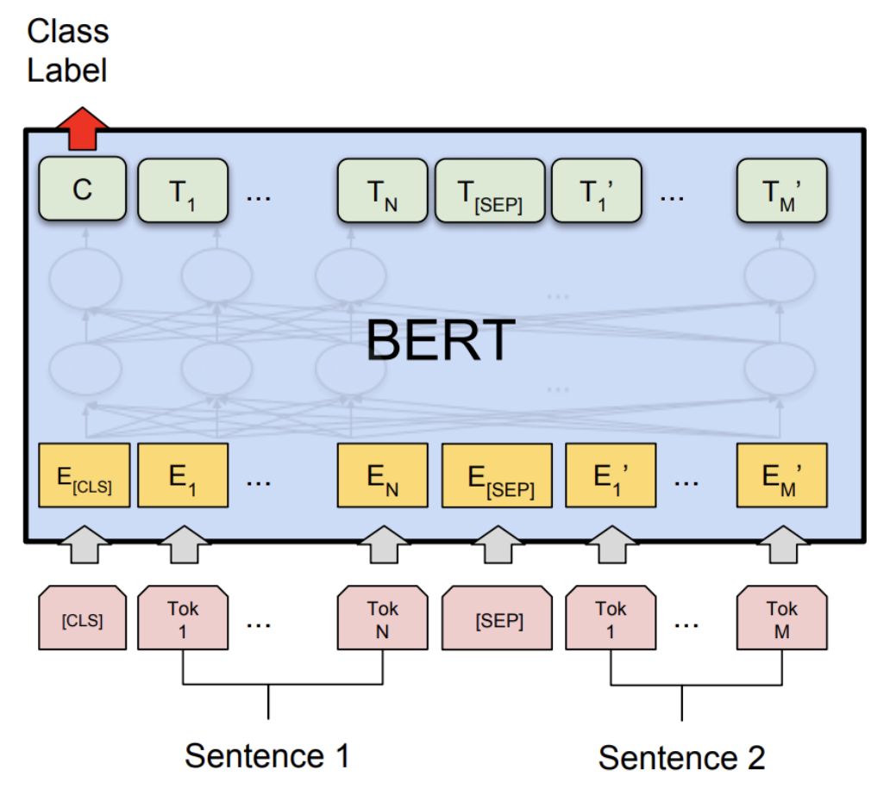
ALGORITHM
4. BERT
BERT is an open source machine learning framework for natural language processing (NLP). BERT is designed to help computers understand the meaning of ambiguous language in text by using surrounding text to establish context. The BERT framework was pre-trained using text from Wikipedia and can be fine-tuned with question and answer datasets.BERT, which stands for Bidirectional Encoder Representations from Transformers, is based on Transformers, a deep learning model in which every output element is connected to every input element, and the weightings between them are dynamically calculated based upon their connection. (In NLP, this process is called attention.)

Slide 23
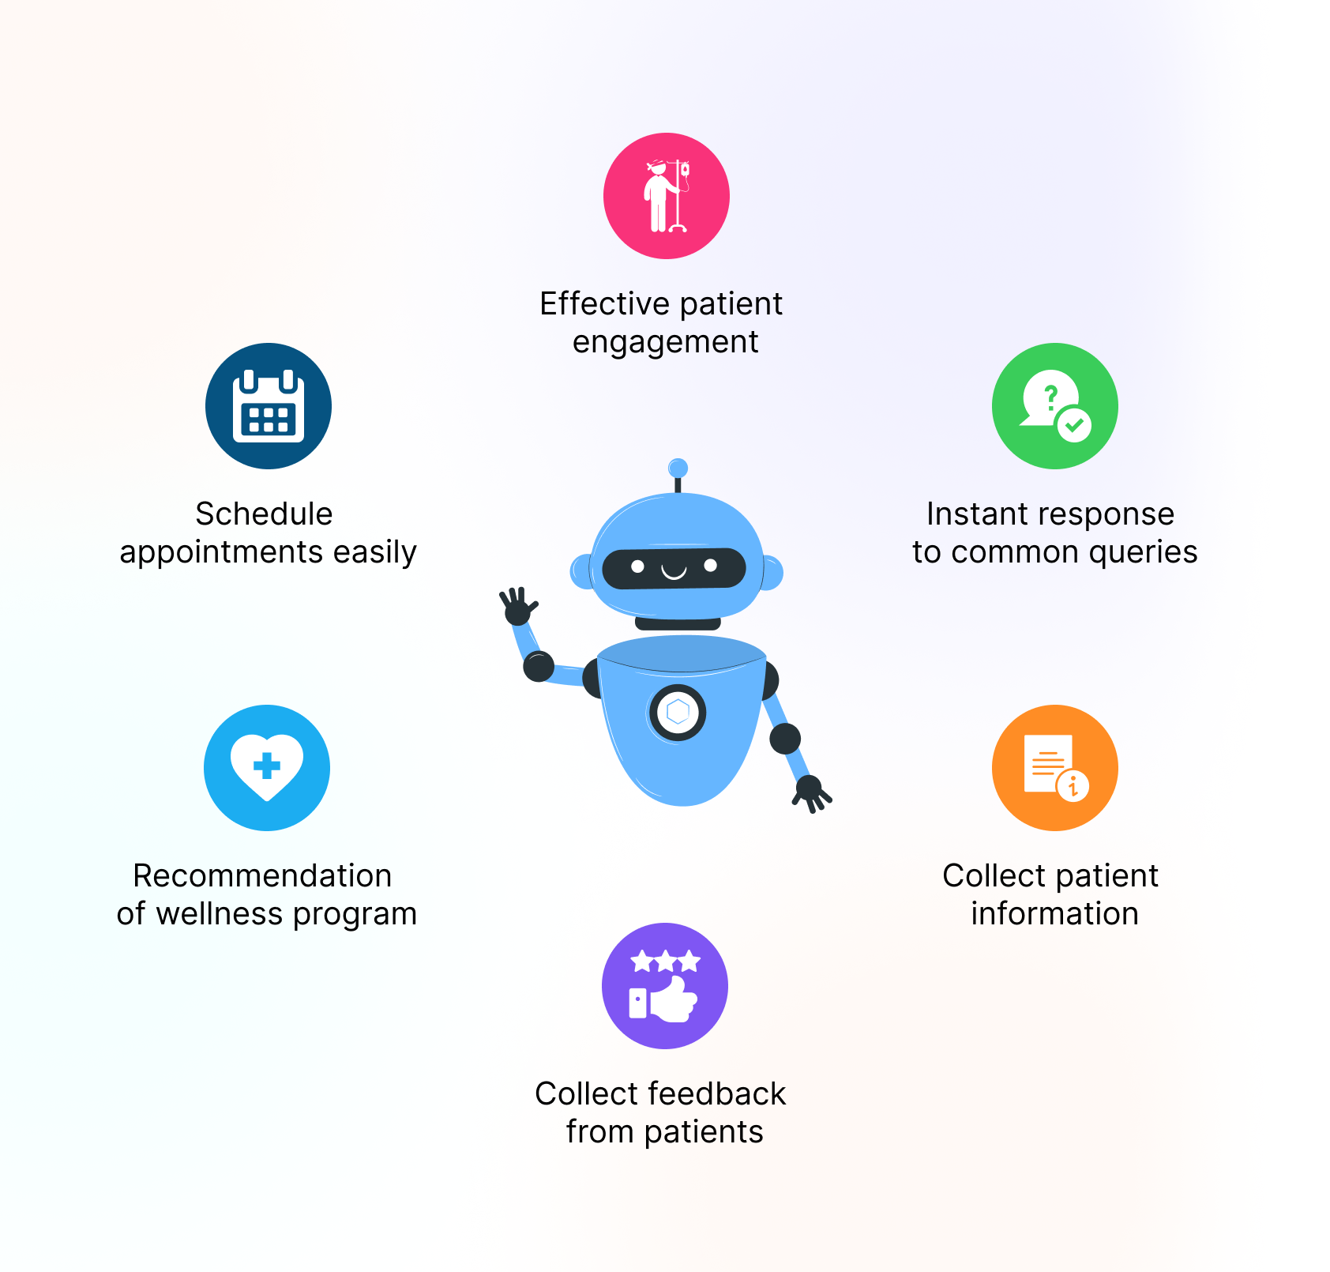
applications
Chatbot can be used for providing informational support
Chatbot can be used to provide medical assistance

Slide 24




CONCLUSION & FUTURE SCOPE
This study demonstrates the implementation of a healthcare question-answer chatbot system. The system can address the health-related queries of the users.
There is a definite scope of development in this area, we can enhance the current model and work towards slowly eliminating the limitations specified.
Future work can involve expanding the system to incorporate optimizers, different algorithms, multilingual ability. Using different dataset system will be able to predict diseases based on the symptoms provided by the user. We can also incorporate voice to text and text to voice functionality to make it user friendly.

Slide 25

Thank you

